Slide 1

CREATE A WORK OF SARt (SYNTHETIC APERTURE RADAR ART)
Team Name : INVICTX
Team members: K.Nandhanaa
S.Abinaya
K.Naveen
L.Pandian
S.D.S.Hari
V.Abhisheik kumar

Slide 2

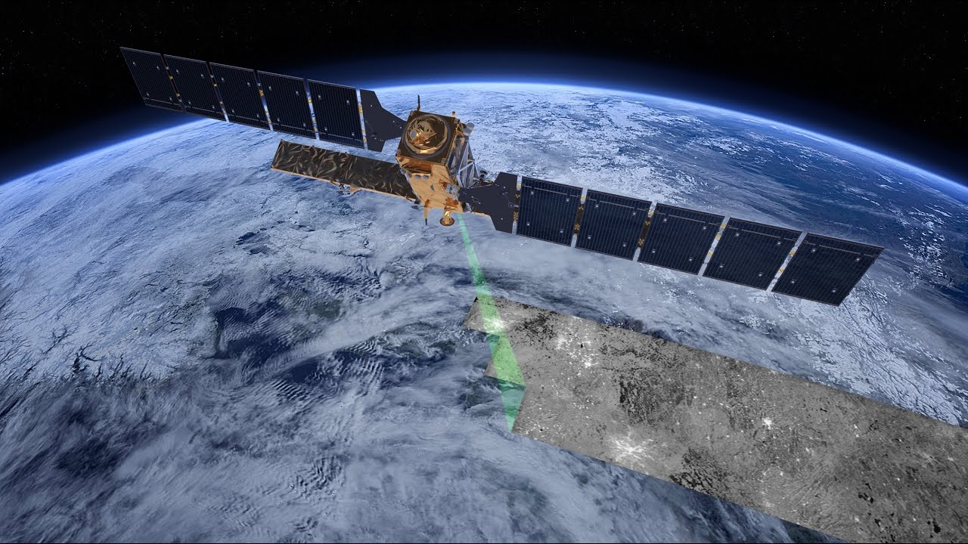
Synthetic Aperture Radar (SAR) is a remote sensing technology that uses radar (radio waves) to create high-resolution images of the Earth's surface. SAR's wizardry lies in its ability to conjure high-resolution images by synthesizing data collected over time, akin to creating a giant virtual camera aperture.

Slide 3

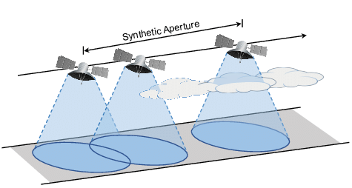
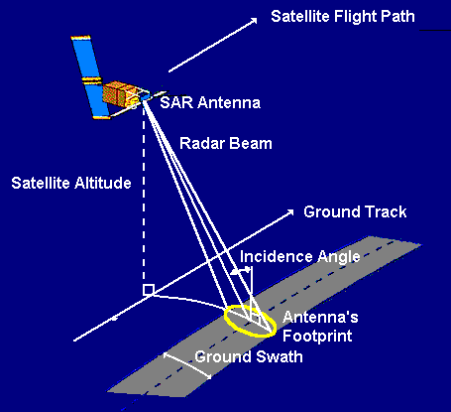
Transmission of Radar Signals: The SAR system emits microwave or radio wave signals, often in the form of pulses, towards the Earth's surface. These signals are transmitted from the SAR antenna. Signal Interaction with the Earth's Surface: When the radar signals reach the Earth's surface, they interact with various objects and features on the ground, including terrain, buildings, vegetation, and water bodies. These interactions can involve reflection, scattering, and absorption of the radar waves. Reception of Reflected Signals: The SAR antenna also serves as a receiver. It collects the signals that are reflected back from the Earth's surface. These reflections are referred to as radar echoes or returns.

Slide 4
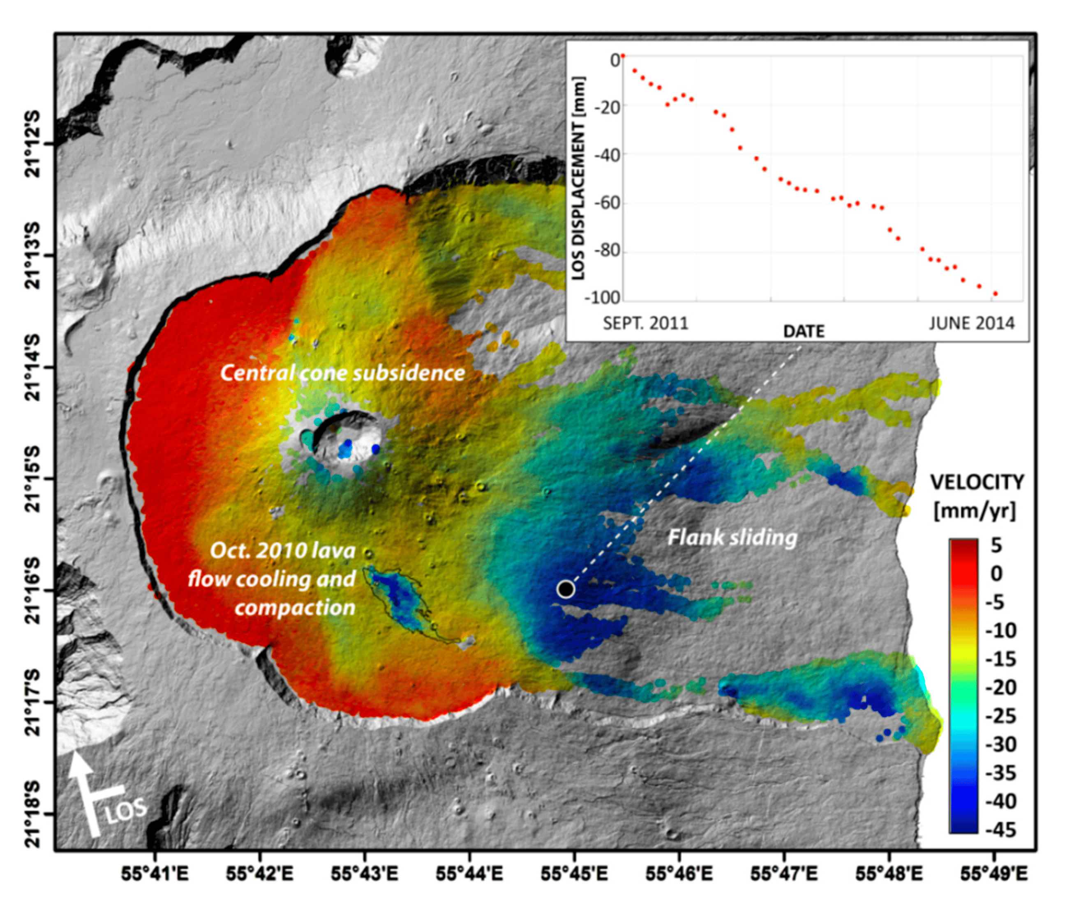
SAR detects ground deformation caused by magma movement, aiding in eruption prediction through interferograms. It provides real-time volcanic activity monitoring, spotting new fissures, lava flows, and crater changes. Continuous SAR surveillance enables prompt warnings and evacuations during volcanic threats. Its capability to assess magma chamber inflation is crucial for assessing volcanic unrest.

Slide 5

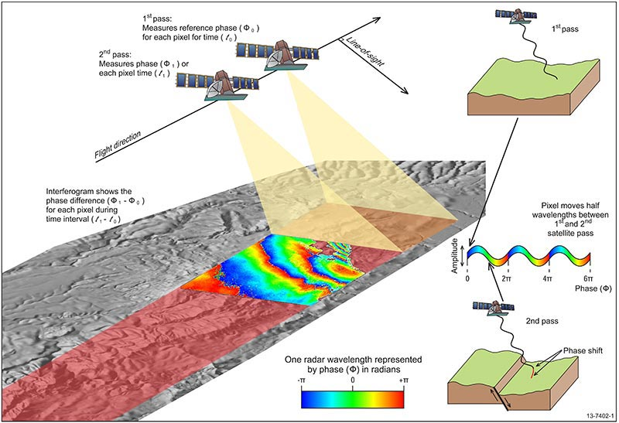
Synthetic Aperture Radar (SAR) can detect earthquakes by capturing ground displacement in high-resolution images. By comparing pre- and post-earthquake SAR data, scientists can analyze the surface deformation, fault movements, and ground shifts caused by seismic events. SAR helps assess earthquake impact, improve early warning systems, and enhance earthquake research.

Slide 6

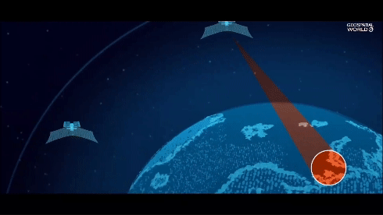
Synthetic Aperture Radar (SAR) offers a transformative solution for remote sensing and Earth observation. Its all-weather capabilities, high-resolution imaging, and versatility make it an invaluable tool for monitoring natural disasters, studying the environment, and aiding disaster response efforts. SAR's continued advancements promise to contribute significantly to our understanding of the Earth's dynamic processes and enhance our ability to address global challenges.

